Slide 1
Automatic Braking System
Kamalpreet Grewal
Jivanjot Singh Bajaj
Ganesh Santhar

Slide 2
Objective
Present a Project proposal in automotive domain based on ARM Cortex M0.
The Proposal consists of below elements
Project goal
Requirements
Architectural design
Implementation Methodology
Cost estimation
Deliverables

Slide 3
Project Description
Topic:
Design and implement Automatic Braking system based on ARM Cortex – M0 microcontroller to detect obstacle for automotive vehicles and prevent it from colliding against the obstacle by braking the system and disabling the acceleration.
Goal: Offer a safety feature to automotive industry.

Slide 4
Requirements
Hardware Requirements:
Freedom board - FRDM-KL25Z
Ultrasonic Sensor - HC-SR04
Motor Driver - L293DNE
Robot Car Chassis kit
Software Requirements:
GCC Cross Compiler Tools for ARM

Slide 5
Architectural Design

Slide 6
Project Development Process
Requirement Analysis
Architectural Design
Coding
Integration
Testing
Deployment

Slide 7
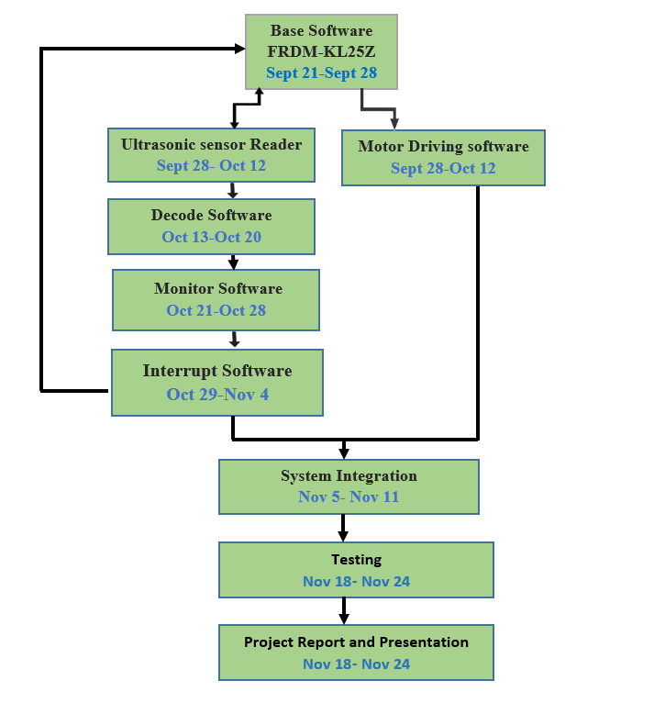
Task & Schedule

Slide 8
Estimation Value
No. | Item | Units | Unit Cost(CAD) | Total Cost(CAD)
1 | Target board – FRDM-KL25Z | 1 | 32 | 32
2 | Ultrasonic Sensor – HC-SR04 | 1 | 4 | 4
3 | Motor Driver - L293DNE | 1 | 4 | 4
4 | Robot Car Chassis kit | 1 | 20 | 20
 | Total Cost |  |  | 60

Slide 9
Deliverables
Design Documents
Simulation Reports
Testing Reports
Working Model
Project Repository
https://github.com/gsanthar/Automatic-Braking-System

